Slide 1

Data Analyst Program
Class 4, Group 2
Final Project
December 2023

Slide 2

Group’s Members:
Eyal Vultz
Yoav Abadi
Oded Mark
Dan Dwek

Slide 3
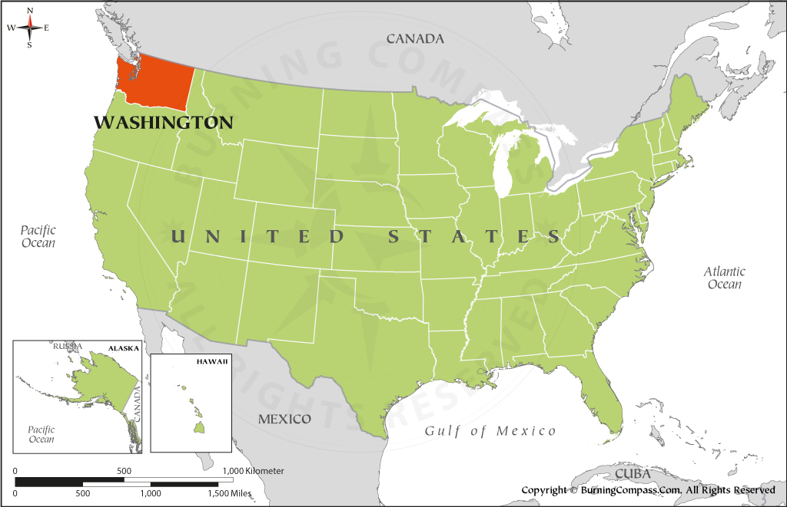

Data Analysis Goal:
Strategy guidance for a short-term investment in a property at Washington, United States.
Data Source:

Slide 4

KPI Definition:
Analysis Strategy:
Characterization of properties with the highest probability to gain the highest Revenue in the Coming Year
Remark: Elimination of the seasonality effect, while still being considered as a short-term period.
Forecasted Revenue in the Coming Year = Price x (365 - availability_365)
Remark: In the absence of the acquisition price of each property data.
Analysis Tool:

Slide 5
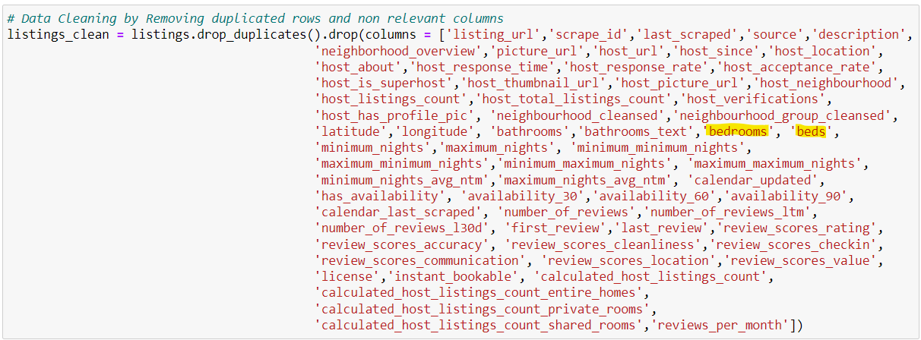
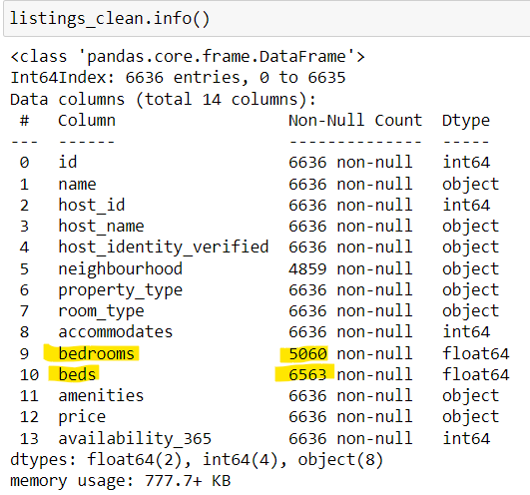
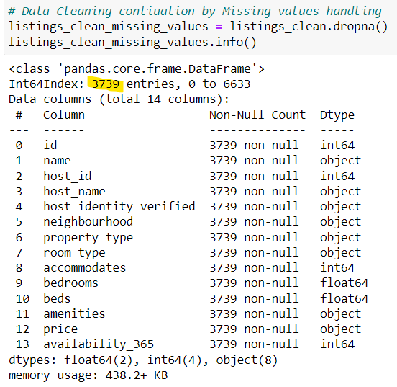
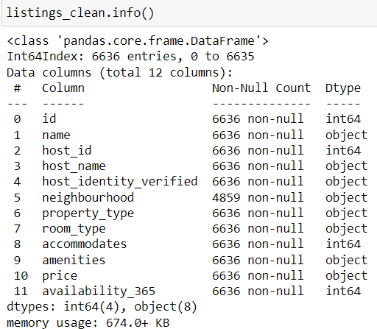
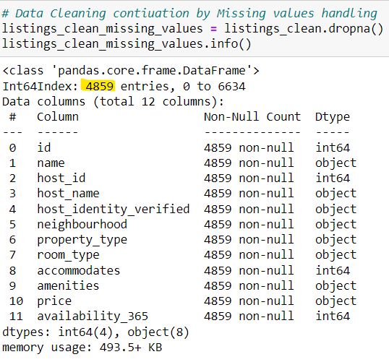
Data Cleaning:
1. Removing duplicated records (rows) and irrelevant fields (columns) resulted also in null entries decrease:
3739
-44%
6636
4859
-27%

Slide 6
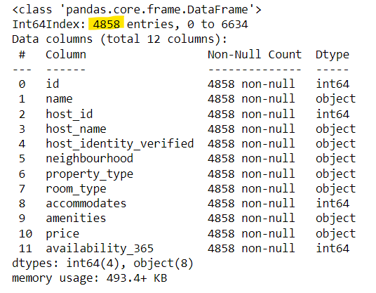
Data Cleaning (cont.):
2. Filtration of only properties which are located in the state of Washington, based on the ‘neighborhood’ filed:
listings_clean_missing_values_Washington
= listings_clean_missing_values[listings_clean_missing_values['neighbourhood'].str.contains("Washington")]
Only a single property of the above was found to be located not in the state of Washington (0.02%, records’ number decreased to 4858).

Slide 7
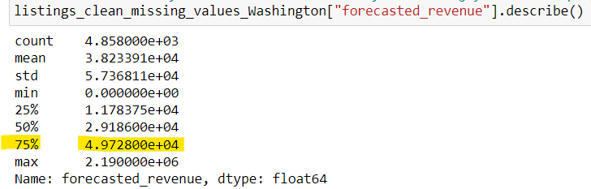
Data Analysis:
Route A:
Trial to specify the KPI’s filtered properties population Top 25% (Q1)

Slide 8
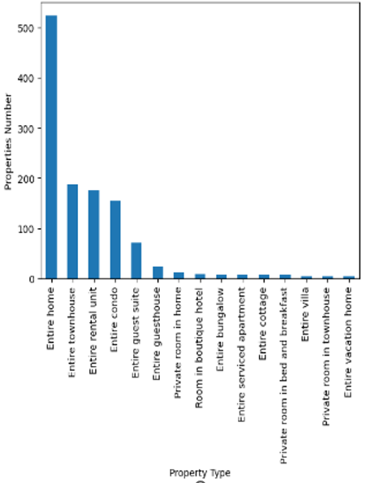
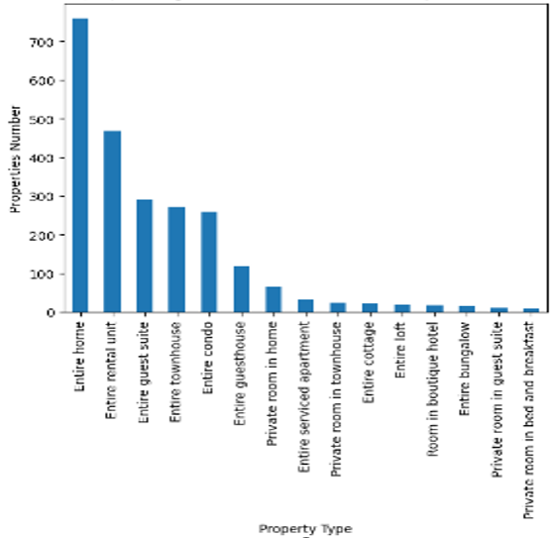
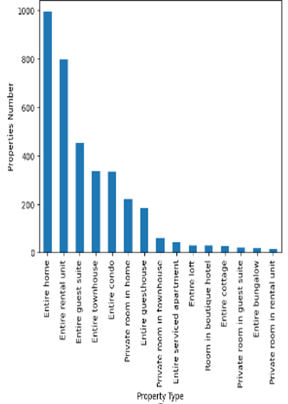
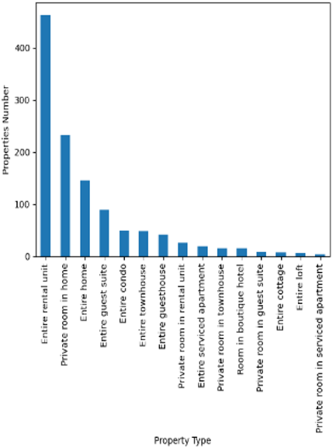
Data Analysis (cont.):
Route A:
The most common Property type in Q1, Q2 and Q3 is Entire home →
Non-Discriminative!
Q1
Q2
Q3
Q4
Notes:
Bar charts

Slide 9
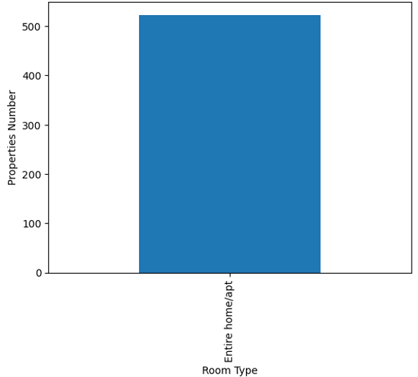
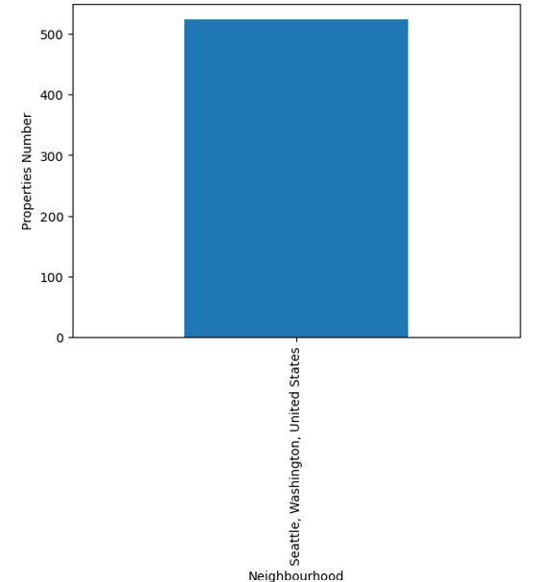
Data Analysis (cont.):
Route A:
All the properties in Q1, Q2 and Q3 which their Property type is Entire home, their Room type is Entire home/apt., and they are located in (Neighborhood) Seattle → Non-Discriminative!

Slide 10
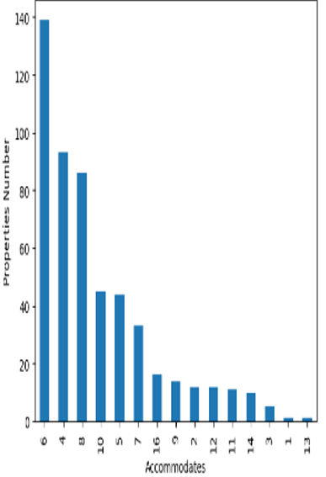
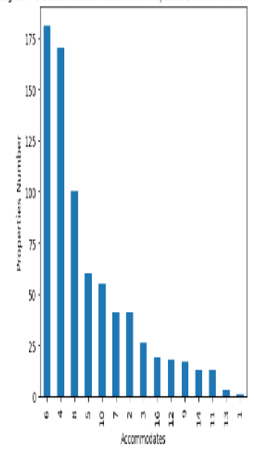
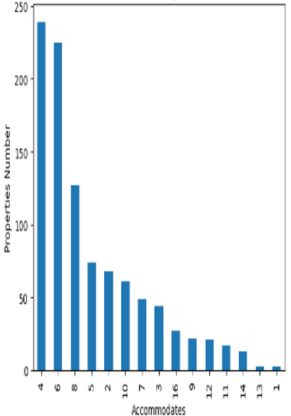
Data Analysis (cont.):
Route A:
The most common Number of Accommodates in Q1, Q2 is 6, while in Q3 it is 4 → Non-Discriminative!
Q1
Q2
Q3

Slide 11
Data Analysis (cont.):
Route A:
Summary Table
Field | Q1 | Q2 | Q3 | Q4
Property Type | Entire home | Entire home | Entire home | Entire rental unit
Room Type | Entire home/apt | Entire home/apt | Entire home/apt
Neighborhood | Seattle | Seattle | Seattle
Accommodates | 6 | 6 | 4
Conclusion:
Trial to specify the TOP 25% (Q1) of the filtered properties according to their Forecasted Revenue in the Coming Year resulted in a Non-Discriminative outcome.

Slide 12
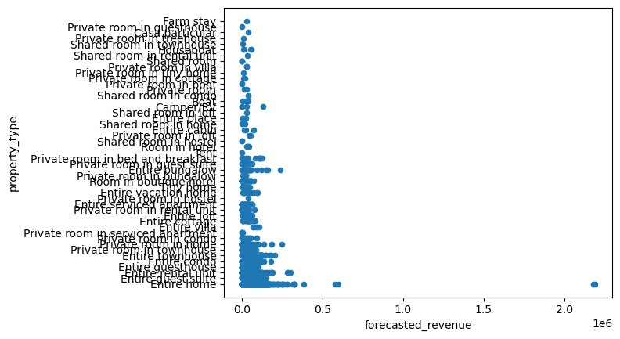
Data Analysis (cont.):
Route B:
Analyzing the entire filtered Properties’ population
Outliers
Remark: The depended variable on the x-axis for convenience
Notes:
Scatter chart

Slide 13
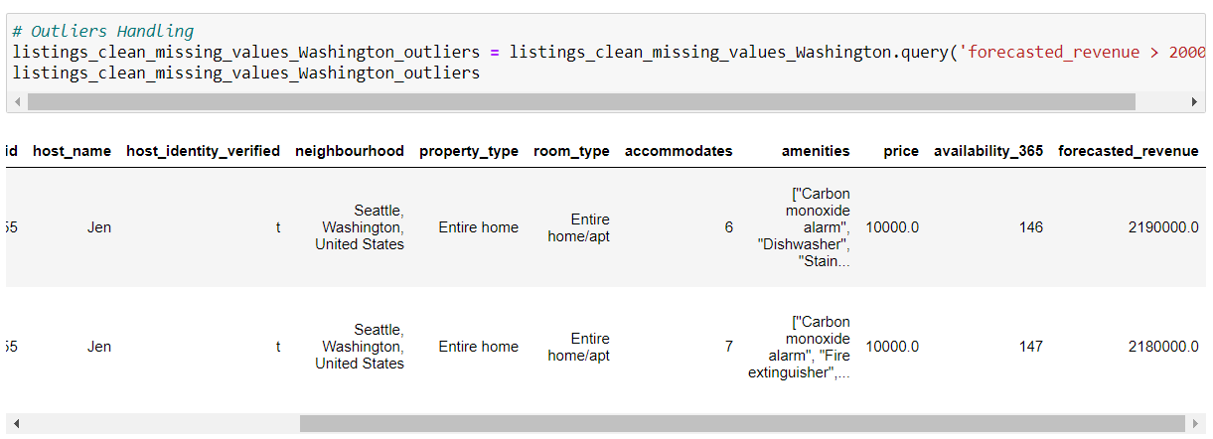
Data Analysis (cont.):
Route B:
Outliers Identification → 2 Outliers (0.04%), and
Removal → records number decreased to 4856 (73% of the Data base).

Slide 14
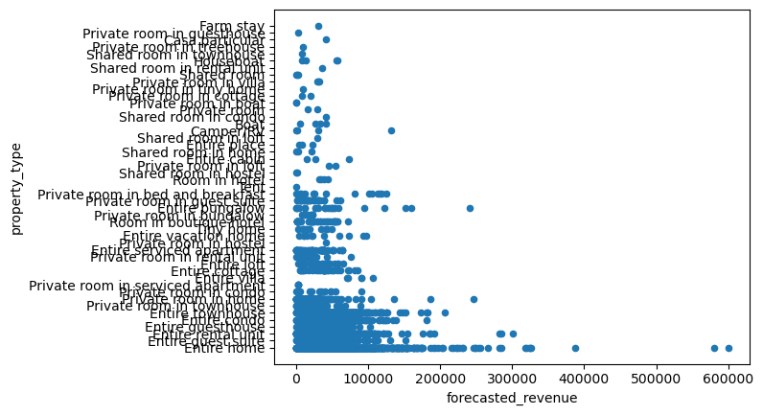
Data Analysis (cont.):
Route B:
Analyzing the entire filtered Properties’ population (outliers’ removal)
Conclusion:
The Type of the properties with the highest Forecasted Revenue in the Coming Year is Entire home.
Remark: The depended variable on the x-axis for convenience

Slide 15
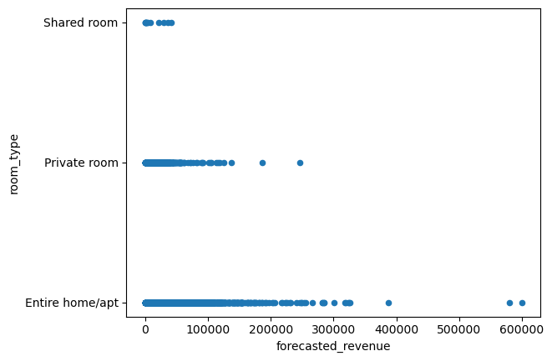
Data Analysis (cont.):
Route B:
Analyzing the entire filtered Properties’ population (outliers’ removal)
Conclusion:
The Room type of the properties with the highest Forecasted Revenue in the Coming Year is Entire home/apt.
Remark: The depended variable on the x-axis for convenience

Slide 16
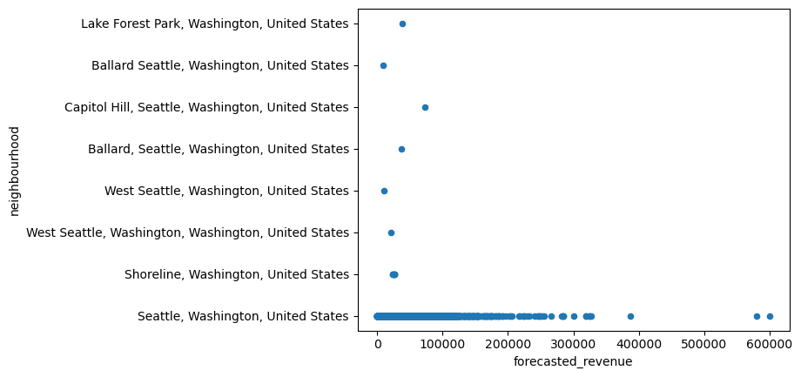
Data Analysis (cont.):
Route B:
Analyzing the entire filtered Properties’ population (outliers' removal)
Conclusion:
The Neighborhood of the properties with the highest Forecasted Revenue in the Coming Year is Seattle.
Remark: The depended variable on the x-axis for convenience

Slide 17
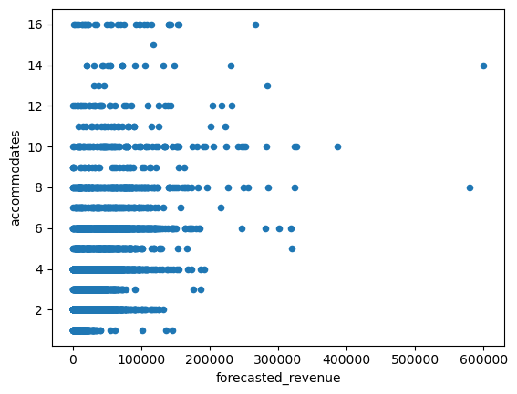
Data Analysis (cont.):
Route B:
Analyzing the entire filtered Properties’ population (outliers’ removal)
Conclusion:
The Number of Accommodates of the properties with the highest Forecasted Revenue in the Coming Year is 6 to 10.
Remark: The depended variable on the x-axis for convenience

Slide 18
Conclusion:
The properties with the highest Forecasted Revenue in Washington, United States in the Coming Year, according to Airbnb data are of Entire Home type, with Entire Home / Apartment room type, located in Seattle, and which are suitable to Accommodate 6 to 10 people.

Slide 19
Thank you for your attention!
Any Questions?

